Slide 1
Pumping Lemma

Slide 2
Some languages are not regular
When is a language is regular? if we are able to construct one of the following: DFA or NFA or ε -NFA or regular expression
When is it not? If we can show that no FA can be built for a language

Slide 3
How to prove languages are not regular?
What if we cannot come up with any FA?
A) Can it be language that is not regular?
B) Or is it that we tried wrong approaches?
How do we decisively prove that a language is not regular?
“The hardest thing of all is to find a black cat in a dark room, especially if there is no cat!” -Confucius

Slide 4
Pumping Lemma For Regular Languages
In the theory of formal languages, the pumping lemma for regular languages is a lemma that describes an essential property of all regular languages. Informally, it says that all sufficiently long words in a regular language may be pumped—that is, have a middle section of the word repeated an arbitrary number of times—to produce a new word that also lies within the same language.

Slide 5
Formal Definition
Let L be a regular language. Then there exists an integer p>=1 depending only on L such that every string w in L of length at least p (p is called the "pumping length") can be written as w=xyz (i.e., w can be divided into three substrings), satisfying the following conditions:
|y|>=1
|xy|<=p
for all i ≥ 0: xy^{i} z ∈ L
Note that |x| and |z| can be 0 but |y| has to be greater than or equal 1.

Slide 6
Pumping Lemma is used as a proof for irregularity of a language. Thus, if a language is regular, it always satisfies pumping lemma. If there exists at least one string made from pumping which is not in L, then L is surely not regular.
The opposite of this may not always be true. That is, if Pumping Lemma holds, it does not mean that the language is regular.

Slide 7
Conclusion
Pumping Lemma is to be applied to show that certain languages are not regular. It should never be used to show a language is regular.
If L is regular, it satisfies Pumping Lemma.
If L does not satisfy Pumping Lemma, it is non-regular.

Slide 8
The Purpose of the Pumping Lemma for RL
To prove that some languages cannot be regular.

Slide 9
How to use the pumping lemma?
Think of playing a 2 person game
Role 1: We claim that the language cannot be regular
Role 2: An adversary who claims the language is regular
We show that the adversary’s statement will lead to a contradiction that implyies pumping lemma cannot hold for the language.
We win!!

Slide 10
How to use the pumping lemma? (The Steps)
(we) L is not regular.
(adv.) Claims that L is regular and gives you a value for N as its P/L constant
(we) Using N, choose a string w ∈ L s.t.,
|w| ≥ N,
Using w as the template, construct other words w_{k} of the form xy^{k}z and show that at least one such w_{k} ∉ L
=> this implies we have successfully broken the pumping lemma for the language, and hence that the adversary is wrong.
(Note: In this process, we may have to try many values of k, starting with k=0, and then 2, 3, .. so on, until w_{k} ∉ L )

Slide 11
Example of using the Pumping Lemma to prove that a language is not regular
Note: This N can be anything (need not necessarily be the #states in the DFA. It’s the adversary’s choice.)
Let L_{eq} = {w | w is a binary string with equal number of 1s and 0s}
Your Claim: L_{eq} is not regular
Proof:
By contradiction, let L_{eq} be regular
P/L constant should exist
Let N = that P/L constant
Consider input w = 0^{N}1^{N} (your choice for the template string)
By pumping lemma, we should be able to break w=xyz, such that:
y≠ ε
|xy|≤N
For all k≥0, the string xy^{k}z is also in L
➔ adv.
➔ adv.
➔ you
➔you

Slide 12
Proof…
Template string w = 0^{N}1^{N} = 00 …. 011 … 1
N
N
Because |xy|≤N, xy should contain only 0s
(This and because y≠ ε, implies y=0⁺)
Therefore x can contain at most N-1 0s
Also, all the N 1s must be inside z
By (3), any string of the form xy^{k}z ∈ L_{eq} for all k≥0
Case k=0: xz has at most N-1 0s but has N 1s
Therefore, xy⁰z ∉ L_{eq}
This violates the P/L (a contradiction)
➔ you
Setting k=0 is referred to as “pumping down”
Another way of proving this will be to show that if the #0s is arbitrarily pumped up (e.g., k=2), then the #0s will become exceed the #1s
Setting k>1 is referred to as “pumping up”

Slide 13
Exercise 2
Prove L = {0^{n}10^{n} | n≥ 1} is not regular
Note: This n is not to be confused with the pumping lemma constant N. That can be different.
In other words, the above question is same as proving:
L = {0^{m}10^{m} | m≥ 1} is not regular

Slide 14
Example 3: Pumping Lemma
Claim: L = { 0^{i} | i is a perfect square} is not regular
Proof:
By contradiction, let L be regular.
P/L should apply
Let N = P/L constant
Choose w=0^{N2}
By pumping lemma, w=xyz satisfying all three rules
By rules (1) & (2), y has between 1 and N 0s
By rule (3), any string of the form xy^{k}z is also in L for all k≥0
Case k=0:
#zeros (xy⁰z) = #zeros (xyz) - #zeros (y)
N² – N ≤ #zeros (xy⁰z) ≤ N² - 1
(N-1)² < N² - N ≤ #zeros (xy⁰z) ≤ N² - 1 < N²
xy⁰z ∉ L
But the above will complete the proof ONLY IF N>1.
… (proof contd.. Next slide)

Slide 15
Example 3: Pumping Lemma
(proof contd…)
If the adversary pick N=1, then (N-1)² ≤ N² – N, and therefore the #zeros(xy⁰z) could end up being a perfect square!
This means that pumping down (i.e., setting k=0) is not giving us the proof!
So lets try pumping up next…
Case k=2:
#zeros (xy²z) = #zeros (xyz) + #zeros (y)
N² + 1 ≤ #zeros (xy²z) ≤ N² + N
N² < N² + 1 ≤ #zeros (xy²z) ≤ N² + N < (N+1)²
xy²z ∉ L
(Notice that the above should hold for all possible N values of N>0. Therefore, this completes the proof.)

Slide 16
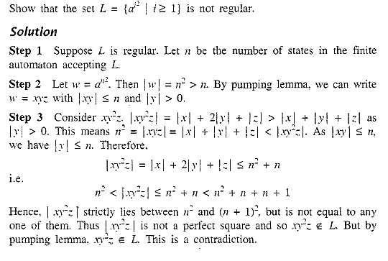
Practice Question

Slide 17
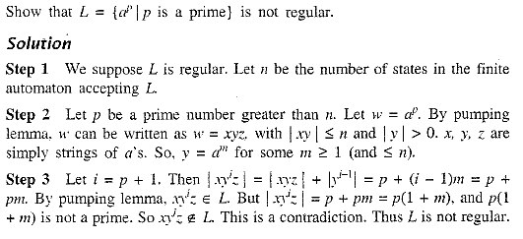

Slide 18
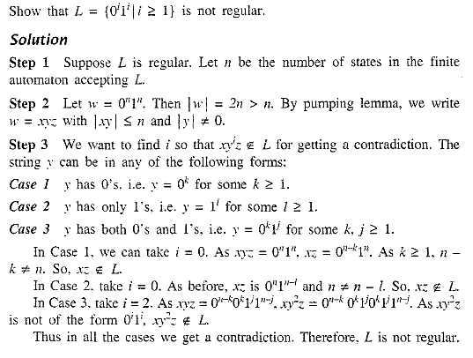

Slide 19
POLLING QUESTIONS
1. While applying Pumping lemma over a language, we consider a string w that belong to L and fragment it into _________ parts. a) 2 b) 5 c) 3 d) 6
Notes:
c

Slide 20
2. If we select a string w such that w∈L, and w=xyz. Which of the following portions cannot be an empty string? a) x b) y c) z d) all of the mentioned
Notes:
b

Slide 21
3. Answer in accordance to the third and last statement in pumping lemma: For all _______ xy^{i}z ∈L a) i>0 b) i<0 c) i<=0 d) i>=0
Notes:
d

